Slide 1
New Zealand Tourism and Accommodations Time Series Analysis
Timothy Lu
Springboard Capstone 2022

Slide 2
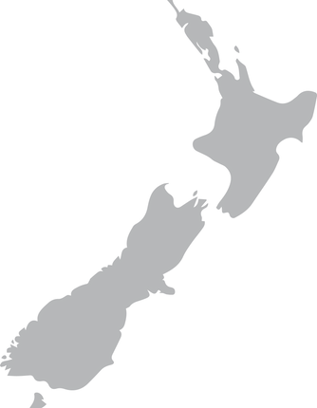
Goals of the Project
Post COVID-19 is seeing the return of visitors to New Zealand
Time series analysis helps us understand trend and forecast into the future
Understanding travel trends and demands is critical for governments
Key Question:
What can the government of New Zealand expect regarding visitors?

Slide 3

Data Source
Data directly from New Zealand Government via Infoshare (https://infoshare.stats.govt.nz/Default.aspx)
Data collected:
Visitor data from foreign countries to New Zealand airports from 1978-2022
Accommodations data for regions in New Zealand from 2001-2019

Slide 4
Data Exploration
Accommodations dataset broken down to components:
Type of accommodation: Hotel, Motel, Backpacker, Holiday Park, All Accommodations
Region: Various New Zealand Regions
Arrivals dataset broken down to components:
Reason for travel: Business, Holiday/Vacation, Visiting Friends, Total Visitors
Airport: Various New Zealand Airports
Decision: Pick time series with complete data and parallels in both datasets
Compare across all types for similar regions

Slide 5
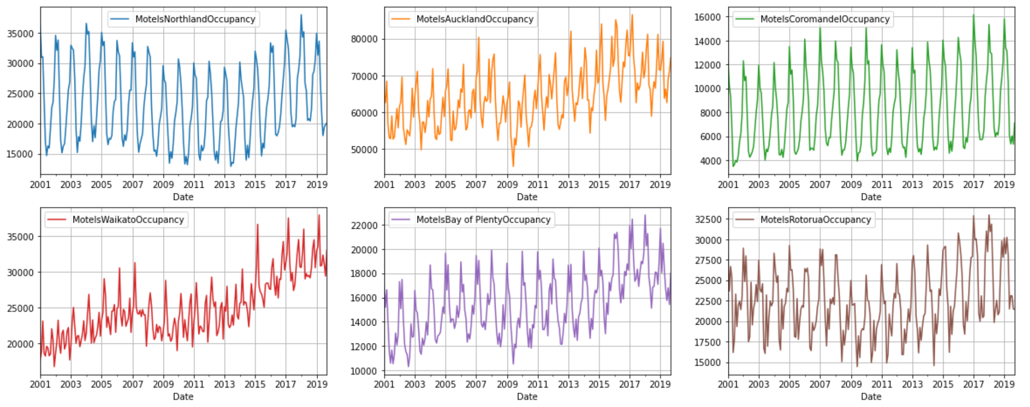
Accommodations Exploration
Final regions of interest:
Regions: Auckland, Canterbury, Wellington, Queenstown, Total New Zealand
Types of Accommodation: Motels, Hotels, All Accommodations
Regions chosen for their parallels with airports
Types of accommodation chosen for their market share and continuous time series data
Observed seasonality across regions and trending growth in some accommodation types

Slide 6
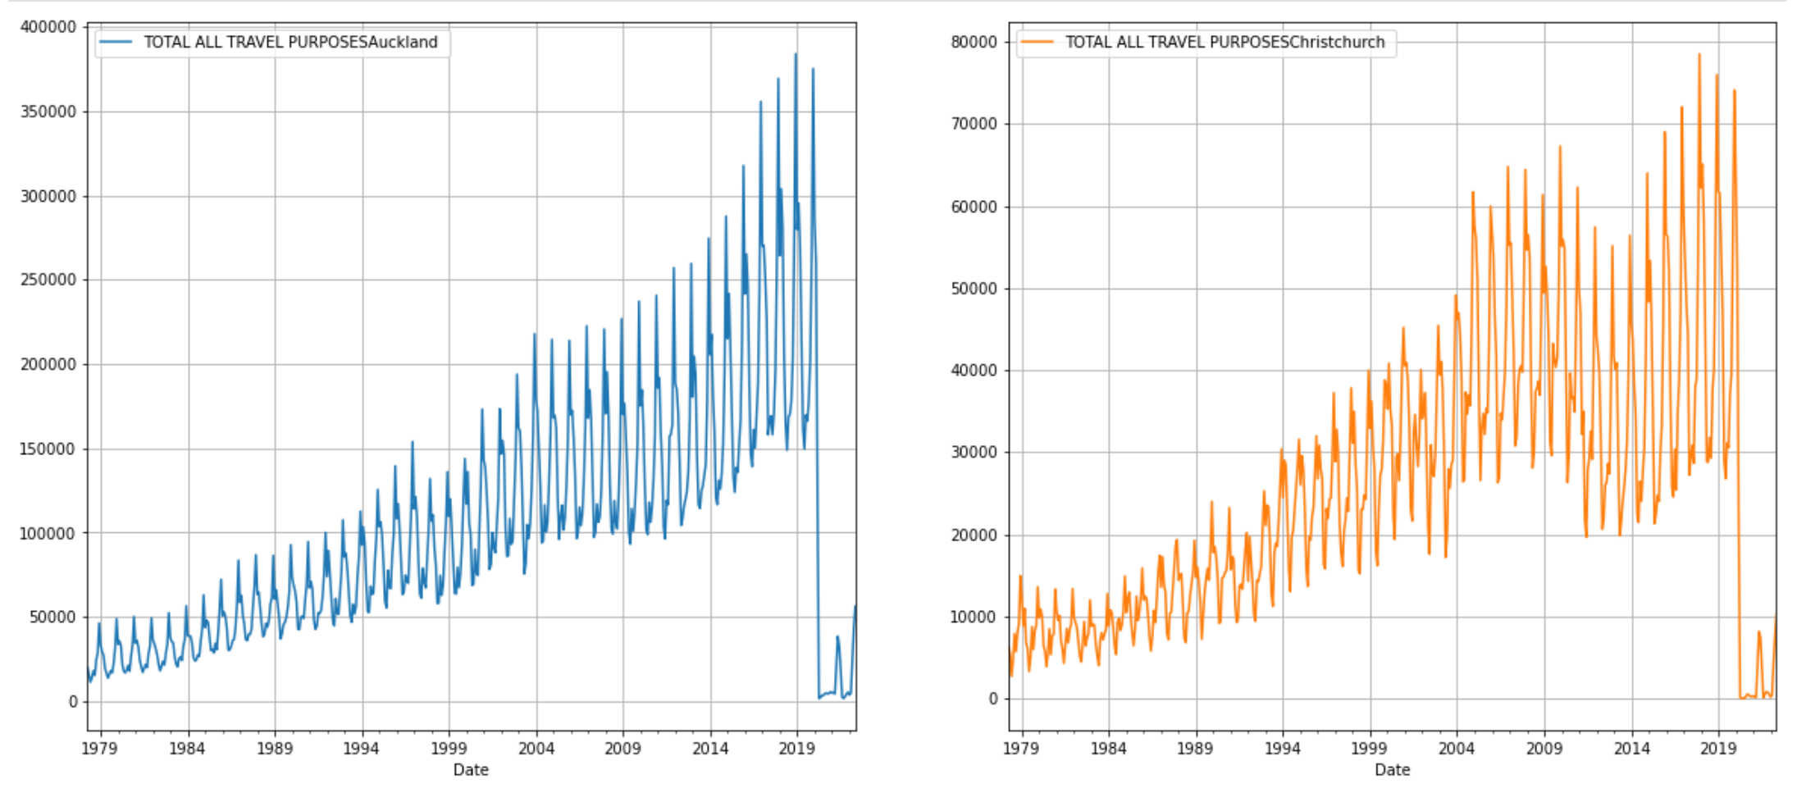
Tourism Arrivals Exploration
Greatly impacted by COVID-19 Data
We can see seasonal trends and some trending growth
Regions: Auckland, Christchurch (Canterbury), Queenstown, Wellington, All New Zealand
Reasons: Business, Holiday, Visiting Friends, All Reasons
Regions chosen to parallel Accommodations

Slide 7
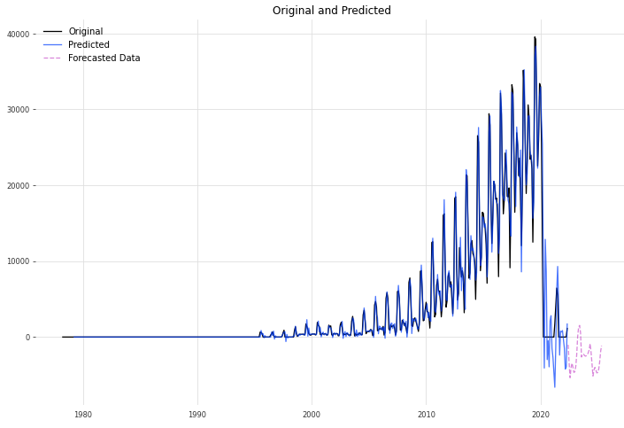
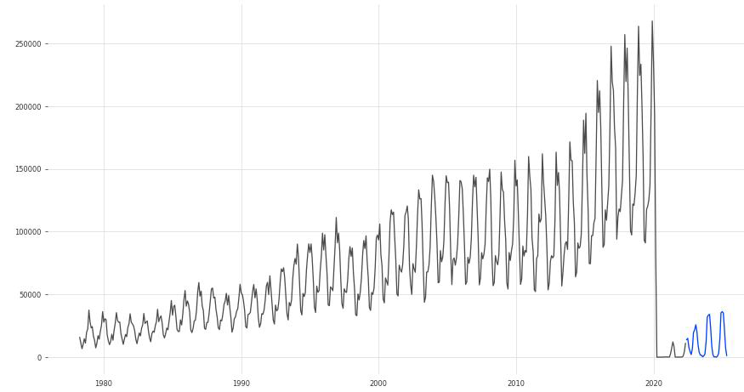
Tourist Data Forecasting
Drop in tourism caused by COVID-19 caused many models to struggle
Some models like SARIMAX forecasted negative visitors
Queenstown Total Visitors data had this, we adjusted
Some models like BATS and ETS performed well – recommend using these
SARIMAX model on Queenstown Total Tourism
BATS model on All Tourism New Zealand

Slide 8
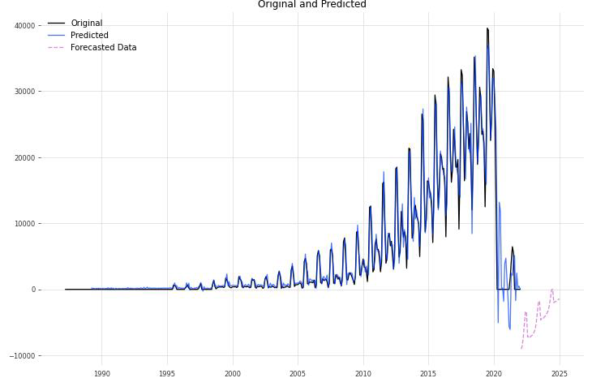
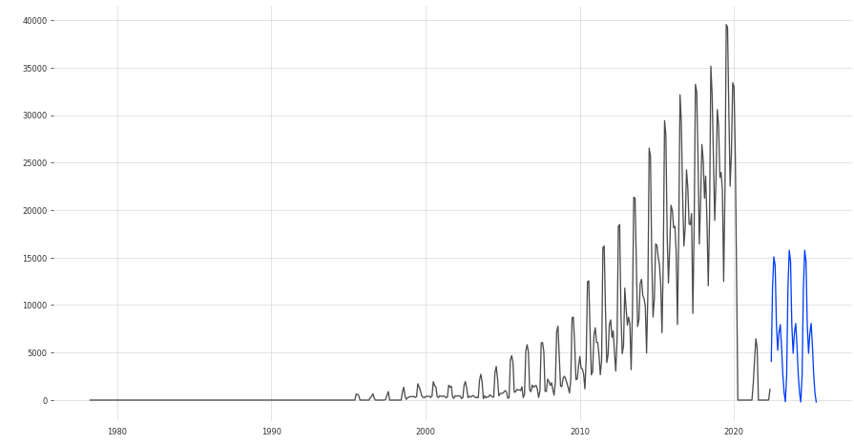
Recommending Different Forecasting Models
Two attempts to improve forecasting on Queenstown Total Tourism
Add other factors like GDP to our model
Did not resolve negative forecasting BUT reinforced upward trend
Use BATS modeling on the timeseries – solved negative forecasting issue

Slide 9
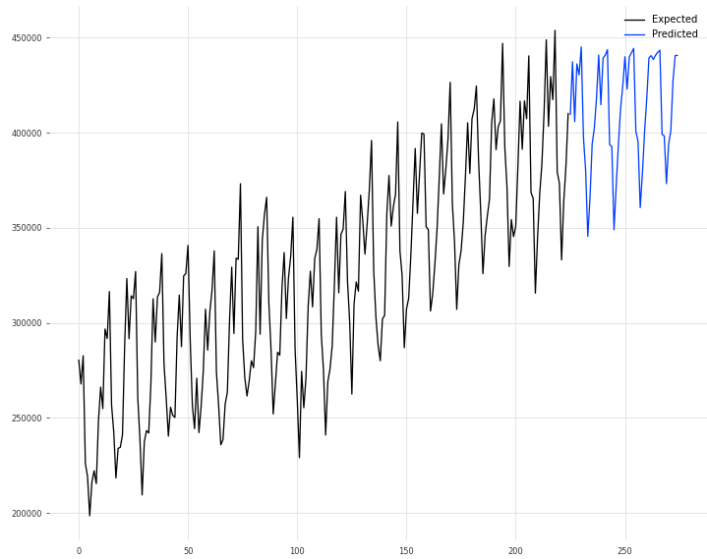
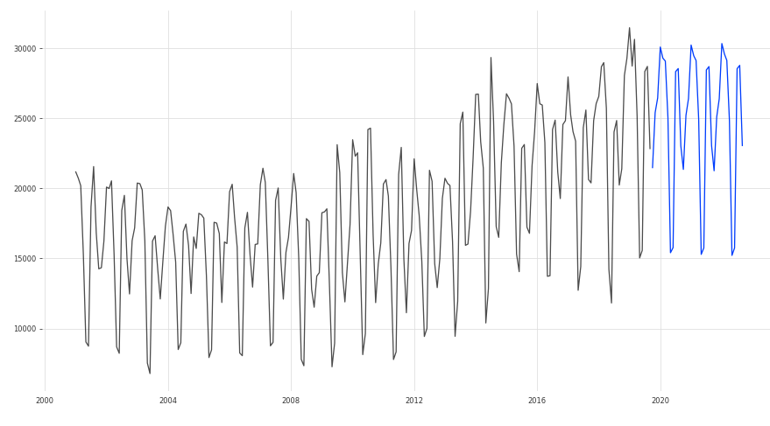
Accommodations Forecasting
Did not have COVID-19 data
Overall models performed well
We can expect similar seasonal trends with a slight upwards growth in these industries
Total Auckland Occupancy
Motel Queenstown Occupancy

Slide 10
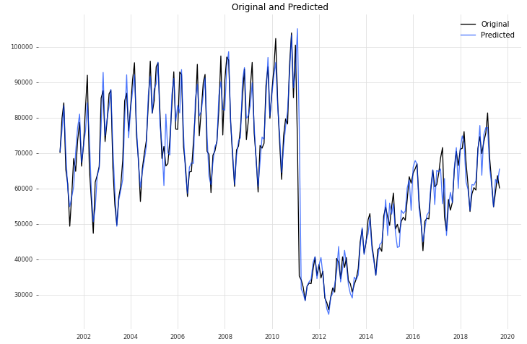
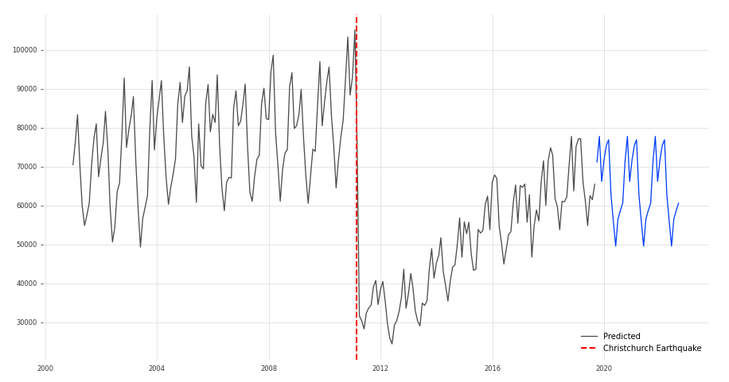
Accommodations Christchurch Hotel Model
February 2011, Christchurch Earthquake – major event
Caused a huge plummet in tourism
Slight parallel to COVID-19 data and we can observe model performance
Initially a lag and difficulty with predictions but corrected itself after some seasonal cycles

Slide 11
Recommendations
COVID-19 Data should tentatively be modeled using BATS to prevent negative forecasts
New Zealand Government should update data as quickly as possible
New data will allow time series models to more accurately predict as we exit the COVID-19 pandemic
When new data is given in September 2022, update the models
Accommodations industry should prepare for an upcoming holiday season

Slide 12
Constraints and Further Study
Time series data not up-to-date thus limiting forecasting power
Accommodations data only until 2019, could use more recent data to study
Utilizing different exogenous variables to assist in modeling tourism data
Could help with the pandemic forecasting
Pycaret (and similarly DARTS) are a great way to begin initial exploration into time series
Still perform more modeling and manual tuning

Slide 13
Thank you
Timothy Lu
Report: https://github.com/naturesbless/Tourism-Forecasting/blob/main/Proposal%20and%20Reports/New_Zealand_TimeSeries_Capstone_Report.pdf
Github: https://github.com/naturesbless/Tourism-Forecasting

